Slide 1
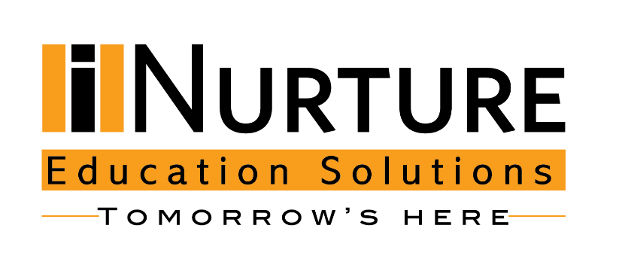
Cloud Platforms
Module Number: 03
Module Name: Cloud Platforms Part I
Version Code: CC1
Released Date: 18-Jul-2018

Slide 2
Fundamentals of Cloud Computing
AIM:
The aim of this module is to enrich students with an understanding of public and private cloud platforms and their impact.
2

Slide 3
Introduction to Operating System
Objectives:
The Objectives of this module are:
To explain public cloud platforms using AWS, Azure, Google cloud, and Salesforce.com as examples.
To explain private cloud platforms using azure stack, open stack and AWS Greengrass as examples
To discuss the seven-step model for cloud migration
To describe the risks and risk mitigation methodology
2

Slide 4
Introduction to Operating System
Outcome:
At the end of this module, you are expected to:
Discuss the various public cloud platforms and their importance.
Explain the private cloud platforms using examples.
Determine the impact of public and private cloud platforms
Describe the seven step model of cloud migration
Identify the risks of using cloud
2

Slide 5
Introduction to Operating System
Contents
Cloud platforms
Cloud Platform Technologies
AWS
Microsoft azure
Google Cloud Platform
Salesforce.com
Impact of cloud platforms
Private Cloud Platforms
Microsoft Microsoft Azure stack
Open stack
AWS Greengrass
Impact of private clouds
Cloud Migration
Risks
2

Slide 6

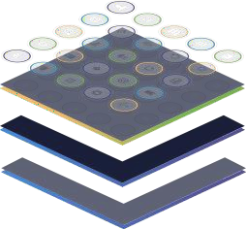
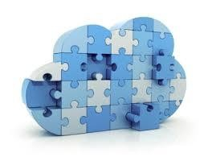
Cloud Platforms
What is Cloud Platform?
A cloud platform is a platform to let developers write applications that run in the cloud, or use services provided from the cloud, or both. It is also called as on-demand platform and platform as a service (PaaS).
NIST defines PaaS as “Platform as a Service is the ability to provide a computing environment and the related development and deployment stack needed to deliver a solution to the consuming customer.”
A typical Cloud platform includes a Cloud application hosting server and a cloud storage device as database. Many also offer additional services such as customizable load balancing and relational databases.
2

Slide 7





Introduction to Operating System
Why to use Cloud Platforms?
Developing in the cloud enables users to get their applications to market quickly. Hardware failures do not result in data loss because of networked backups.
Why to use cloud platforms?
Cloud computing uses remote resources, saving organizations the cost of servers and other equipment.
8

Slide 8



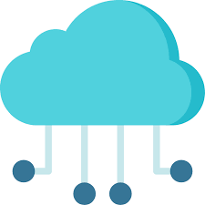
Introduction to Operating System
Evaluating cloud platforms
The criteria to be considered while evaluating cloud platforms are:
Performance: Cloud providers deliver different application performance results based on geographic location and cloud platform architecture. You should expect a cloud provider in your region to offer lower latency Internet access to your applications. Some cloud providers may allow applications to be hosted in one or more geographic locations. That may be especially important for business continuity purposes, or if the applications are being accessed by a global user base.
Technology Stack: Cloud providers have focused their services on a particular software stack, such as Microsoft Azure for .NET. If your application is built using one of these stacks, using these platforms can offer tremendous savings.
9

Slide 9


Introduction to Operating System
Evaluating cloud platforms
The criteria to be considered while evaluating cloud platforms are:
Service level agreements and Reliability: Some service providers guarantee higher levels of service to have a better edge over other providers. Although SLA is a good indicator of the provider’s commitment, its better to rely on customer testimonials for reliability. Comparison services such as CloudSlueth and CloudHarmony can also provide long term statistics.
Cost: Cost is also one of the important factors that should be compared before opting for any cloud platform. The primary driver behind most businesses moving to the cloud is to save money. Almost all cloud providers offer a utility-based pricing model where you can use the resources you need and then simply pay for the resources that you use. Generally, customers are paying for resources on an hourly or monthly basis. When comparing, three pricing dimensions should be considered: computing, storage and bandwidth.
9

Slide 10
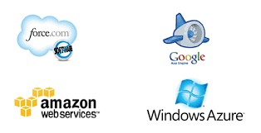
Cloud Platforms
Cloud Platform Technologies
Some of the central players of Cloud Platform Technologies are:
Amazon Web Services
Microsoft Azure
Google Cloud Platform
Salesforce.com

Slide 11
Cloud Platforms
Amazon Web Services

Slide 12
Cloud Platforms
Amazon Web Services
Compute
Storage
Databases and Data management
Migration and Hybrid cloud
Networking
Development tools and application services
Management and Monitoring
Security and Governance
Big data management and Analytics
Artificial intelligence
Mobile development
Messages and Notifications
Other services
AWS pricing models
12

Slide 13
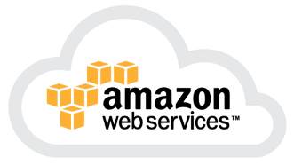

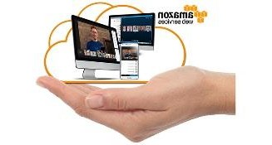
Cloud Platforms
Amazon Web Services (AWS)
Amazon Web Services (AWS) is a comprehensive, evolving cloud computing platform provided by Amazon. It provides a mix of infrastructure as a service (IaaS), platform as a service (PaaS), and packaged software as a service (SaaS) offerings.
AWS was launched in 2006 from the internal infrastructure that Amazon.com built to handle its online retail operations.
AWS was one of the first companies to introduce a pay-as-you-go cloud computing model that scales to provide users with compute, storage or throughput as needed.
Amazon Web Services provides services from dozens of data centers spread across availability zones (AZs) in regions across the world. An AZ represents a location that typically contains multiple physical data centers, while a region is a collection of AZs in geographic proximity connected by low-latency network links.

Slide 14
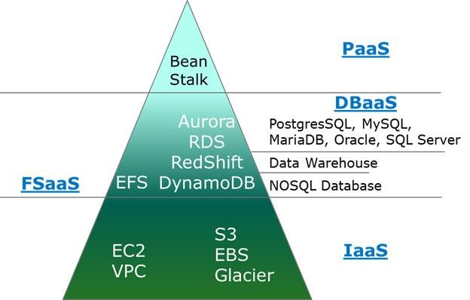
Cloud Platforms
Amazon Web Services (AWS)
The building blocks of EC2, EBS, S3, etc. provide IaaS functionality, in fact AWS is the leader in this category.
From there on, rather than adopting a discrete binary approach of IaaS vs PaaS, AWS has done a great job of viewing it as a continuum and has introduced several services in the middle:
DBaaS – Database as a Service
FSaaS – File System as a Service

Slide 15
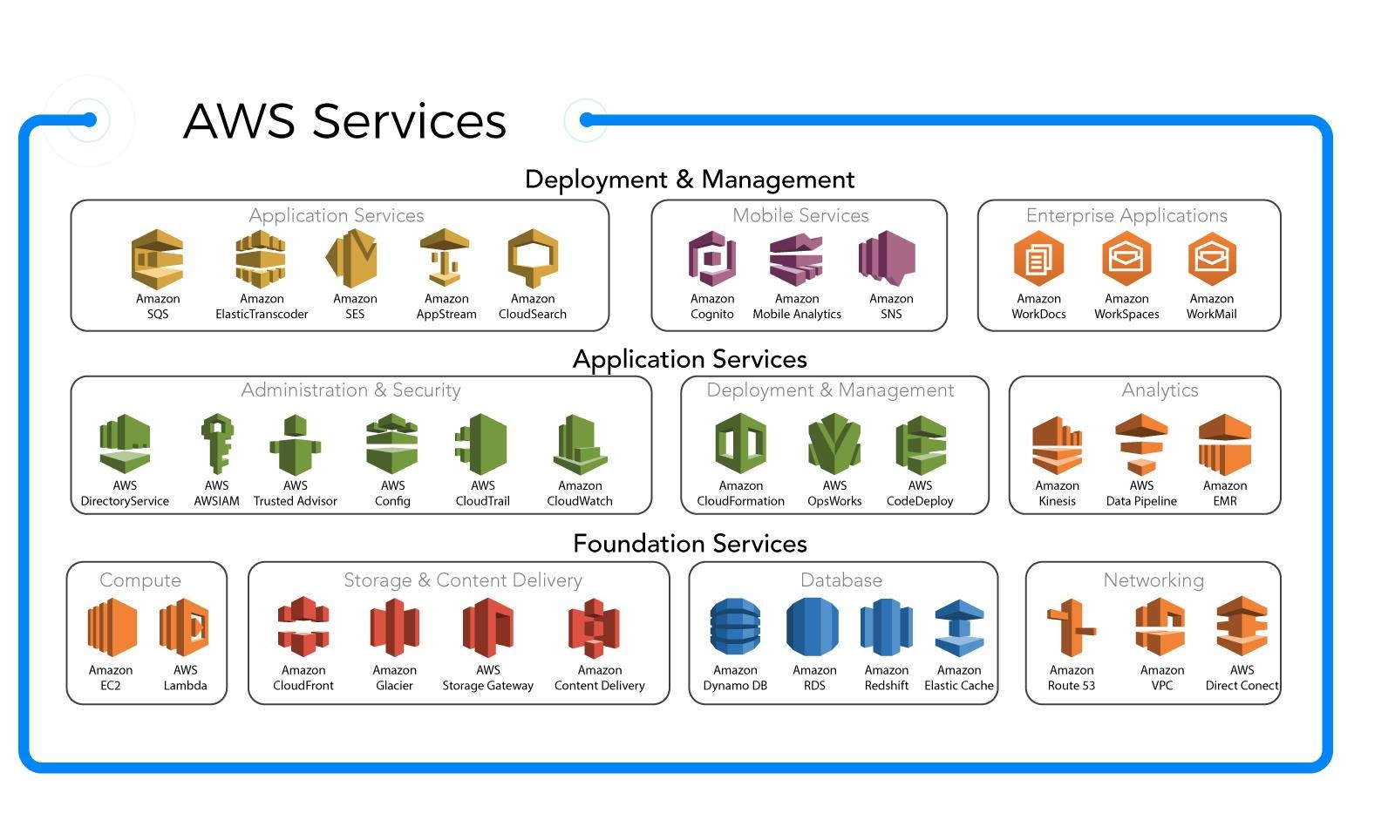
Cloud Platforms
Amazon Web Services (AWS)

Slide 16
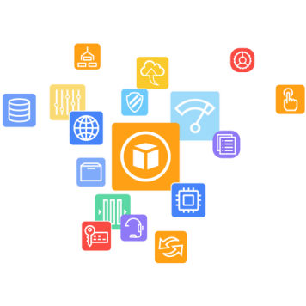
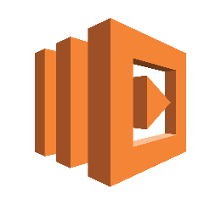
Cloud Platforms
AWS Services
Amazon Web Services is comprised of more than 100 services grouped into categories:
AWS Compute:
Amazon Elastic Compute Cloud (EC2) provides virtual servers, called instances, for compute capacity.
The EC2 service offers dozens of instance types with varying capacities and sizes, tailored to specific workload types and applications, such as memory-intensive and accelerated-computing jobs.
AWS also provides an Auto Scaling tool to dynamically scale capacity to maintain instance health and performance.
A developer can also use AWS Lambda for server-less functions that automatically run code for applications and services.
AWS Elastic Beanstalk can be used for PaaS.
AWS also includes Amazon Lightsail which provides virtual private servers, and AWS Batch which processes a series of jobs.

Slide 17
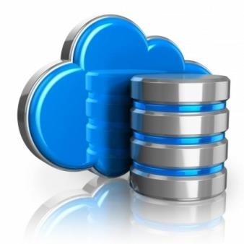

Cloud Platforms
AWS Services
Storage:
When it comes to storage Amazon provides:
S3 Storage for storing objects
Organizations can opt for S3 infrequent storage to save costs
Glacier for long term cold storage of data
Amazon Elastic File System offers managed cloud-based file storage
Amazon Elastic Block Storage for block-level storage
A business can also migrate data to the cloud via physical storage transport devices, such as AWS Snowball
and Snowmobile, or use AWS Storage Gateway to enable on-premises apps to access cloud data.

Slide 18
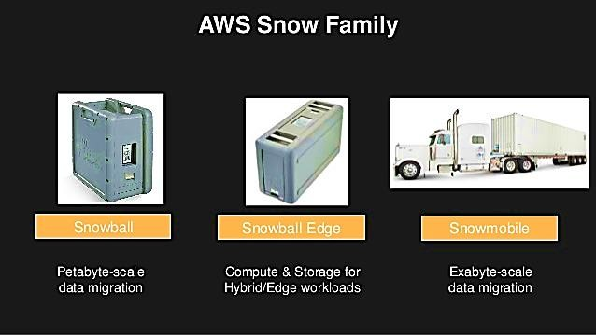
Cloud Platforms
AWS Services – Snow Family

Slide 19
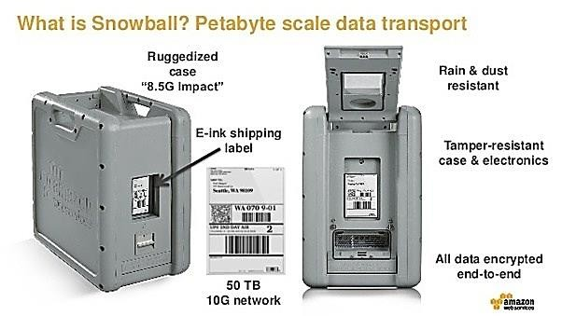
Cloud Platforms
AWS Services - Snowball

Slide 20
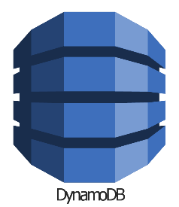
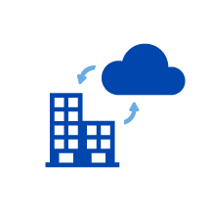

Cloud Platforms
AWS Services:
Databases and data management:
AWS provides managed database services through its Amazon Relational Database Service, which includes options for Oracle, SQL Server, PostgreSQL, MySQL, MariaDB and a proprietary high- performance database called Amazon Aurora. AWS offers managed NoSQL databases through Amazon DynamoDB.
Migration, hybrid cloud:
AWS includes various tools and services designed to help users migrate applications, databases, servers, and data onto its public cloud. The AWS Migration Hub provides a location to monitor and manage migrations from on premises to the cloud. Once in the cloud, EC2 Systems Manager helps an IT team configure on-premises servers and AWS instances.

Slide 21

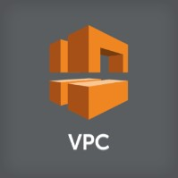
Cloud Platforms
AWS Services:
5. Networking:
An Amazon Virtual Private Cloud (VPC) gives an administrator control over a virtual network to use an isolated section of the AWS cloud. AWS automatically provisions new resources within a VPC for extra protection.
Admins can balance network traffic with AWS load balancing tools, including Application Load Balancer and Network Load Balancer.
AWS also provides a domain name system called Amazon Route 53 that routes end users to applications.
Users can establish a dedicated connection from an on-premises data center to the AWS cloud via AWS
Direct Connect.

Slide 22
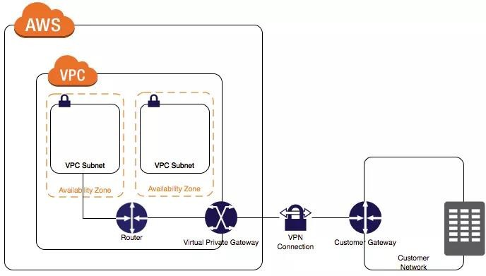
Cloud Platforms
AWS Services – Virtual Private Network

Slide 23
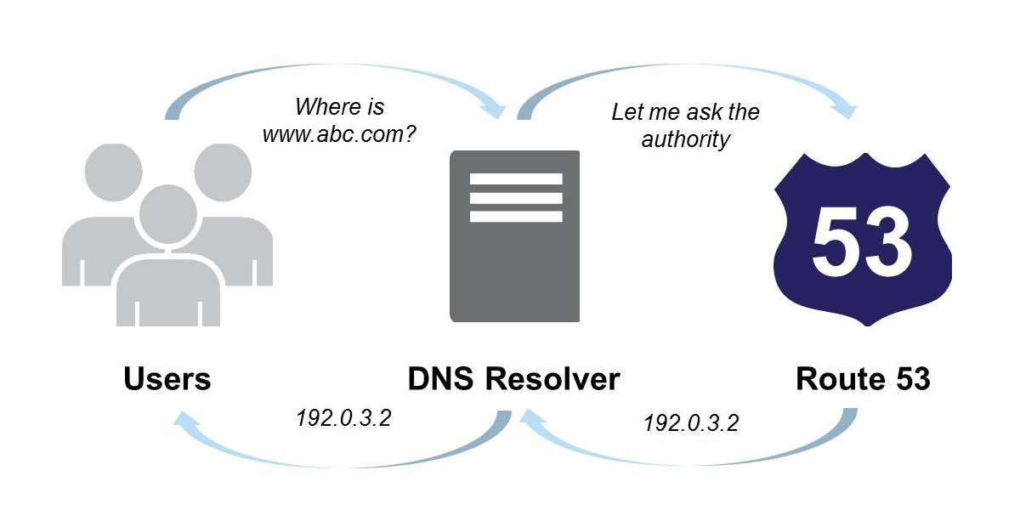
Cloud Platforms
AWS Services – Route53

Slide 24
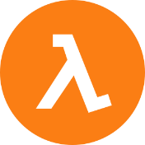
Cloud Platforms
AWS Services
6. Development tools and application services:
AWS command-line tools and software development kits (SDKs) can be used to deploy and manage applications and services. The AWS Command Line Interface is Amazon's proprietary code interface.
A developer can also use AWS Tools for Powershell to manage cloud services from Windows environments and AWS Serverless Application Model to simulate an AWS environment to test Lambda functions.
AWS SDKs are available for a variety of platforms and programming languages, including Java, PHP, Python, Node.js, Ruby, C++, Android, and iOS.
Amazon API Gateway enables a development team to create, manage, and monitor custom APIs that let applications access data or functionality from back-end services. API Gateway manages thousands of concurrent API calls at once.
A development team can also create continuous integration and continuous delivery pipelines with services like AWS CodePipeline, AWS CodeBuild, AWS CodeDeploy and AWS CodeStar.
A developer can also store code in Git repositories with AWS CodeCommit and evaluate the performance of microservices-based applications with AWS X-Ray.
24

Slide 25
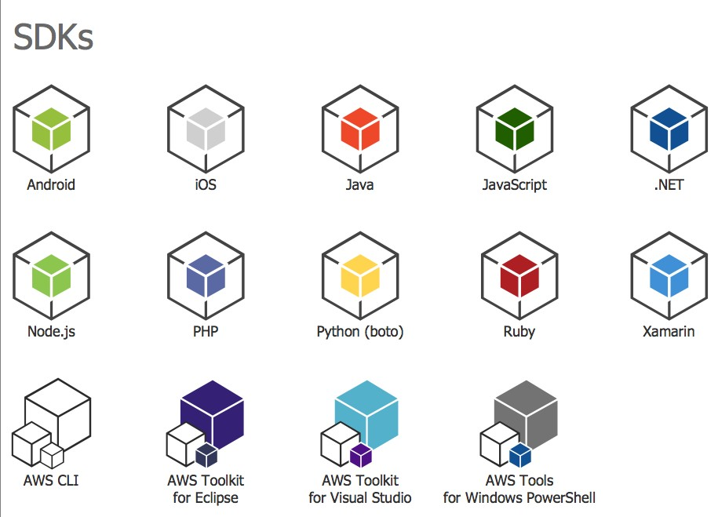
Cloud Platforms
AWS Services – Software Development Kits

Slide 26

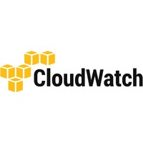
Cloud Platforms
AWS Services:
7. Management and Monitoring:
An admin can manage and track cloud resource configuration via AWS Config and AWS Config Rules. Those tools, along with AWS Trusted Advisor, can help an IT team avoid improperly configured and needlessly expensive cloud resource deployments.
An admin can automate infrastructure provisioning via AWS CloudFormation templates, and also use AWS OpsWorks and Chef to automate infrastructure and system configurations.
An AWS customer can monitor resource and application health with Amazon CloudWatch and the AWS Personal Health Dashboard, and also use AWS CloudTrail to retain user activity and application programming interface (API) calls for auditing.

Slide 27
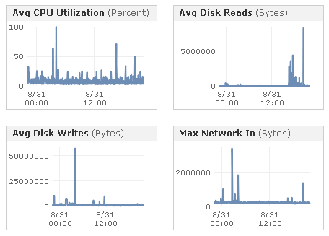
Cloud Platforms
AWS Services – management console

Slide 28

Cloud Platforms
AWS Services
8. Security and Governance:
AWS provides a range of services for cloud security, including AWS Identity and Access Management (IAM), which allows admins to define and manage user access to resources.
An admin can also create a user directory with Amazon Cloud Directory, or connect cloud resources to an existing Microsoft Active Directory with the AWS Directory Service. AWS enables a business to establish and manage policies for multiple AWS accounts.
Amazon Inspector analyzes an AWS environment for vulnerabilities that might impact security and compliance.
Amazon Macie uses machine-learning technology to protect sensitive cloud data.
AWS also includes tools and services that provide software- and hardware-based encryption, protect against DDoS attacks, provision Secure Sockets Layer and Transport Layer Security certificates and filter potentially harmful traffic to web applications.

Slide 29
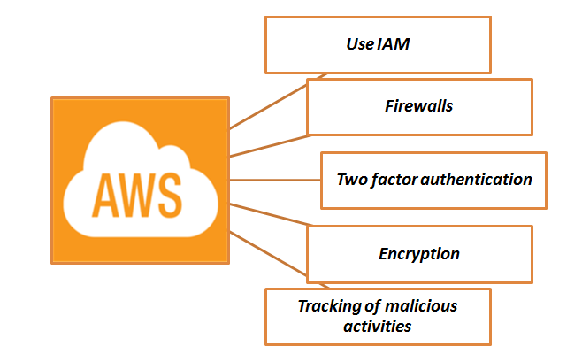
Cloud Platforms
AWS Services – Security

Slide 30

Cloud Platforms
AWS Services:
9. Big data management and analytics
AWS includes a variety of big data analytics and application services. Amazon Elastic MapReduce offers a Hadoop framework to process large amounts of data, while Amazon Kinesis provides several tools to process and analyze streaming data.
AWS Glue is a service that handles extract, transform, and load jobs, while the Amazon Elasticsearch Service enables a team to perform application monitoring, log analysis, and other tasks with the open source Elasticsearch tool.
To query data, an analyst can use Amazon Athena for S3, and then visualize data with Amazon
QuickSight.
30

Slide 31
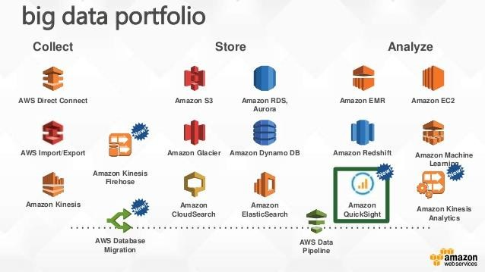
Cloud Platforms
AWS Services – bigdata portfolio

Slide 32




Cloud Platforms
AWS Services:
Artificial intelligence
AWS offers a range of AI model development and delivery platforms, as well as packaged AI-based applications.
The Amazon AI suite of tools includes:
Amazon Lex for voice and text chatbot technology
Amazon Polly for text-to-speech translation
Amazon Rekognition for image and facial analysis.
AWS also provides technology for developers to build smart apps that rely on machine-learning technology and complex algorithms.
On the consumer side, AWS technologies power the Alexa Voice Services, and a developer can use the
Alexa Skills Kit to build voice-based apps for Echo devices.
32

Slide 33
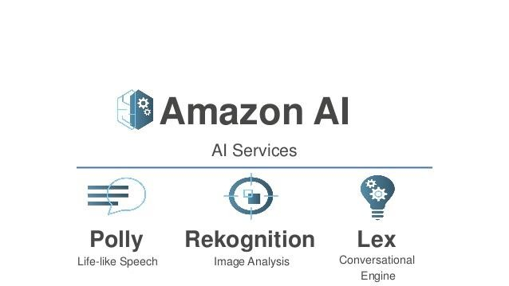
Cloud Platforms
AWS Services – Artificial intelligence

Slide 34

Cloud Platforms
AWS Services:
11. Mobile Development
The AWS Mobile Hub offers a collection of tools and services for mobile app developers, including the AWS Mobile SDK, which provides code samples and libraries.
A mobile app developer can also use Amazon Cognito to manage user access to mobile apps.
Amazon Pinpoint to send push notifications to application-end users and then analyze the effectiveness of those communications.
34

Slide 35
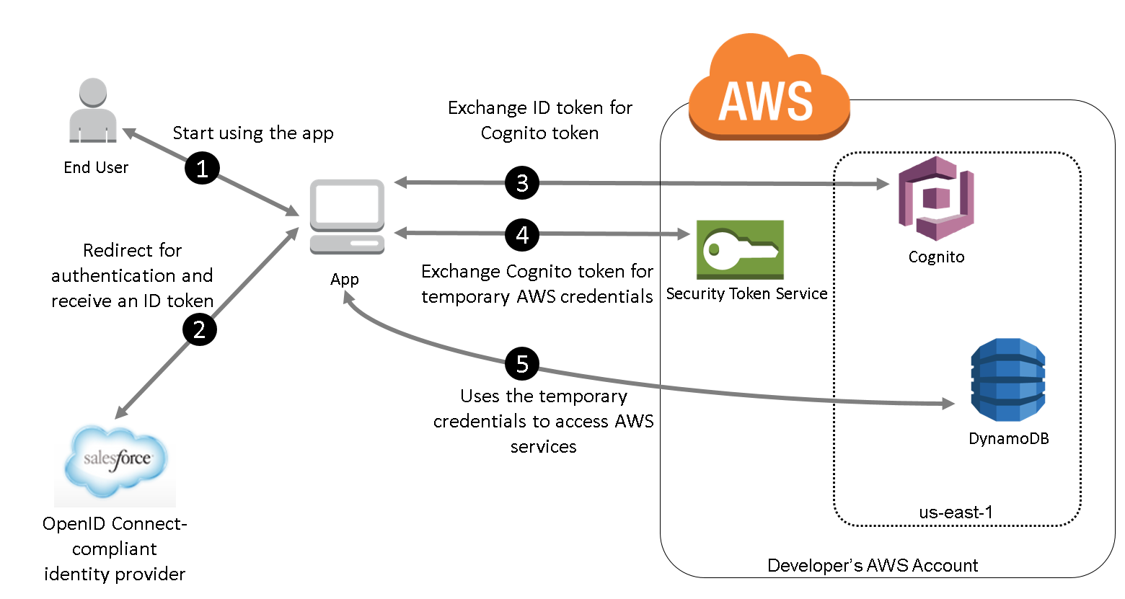
Cloud Platforms
AWS Services – Artificial intelligence

Slide 36


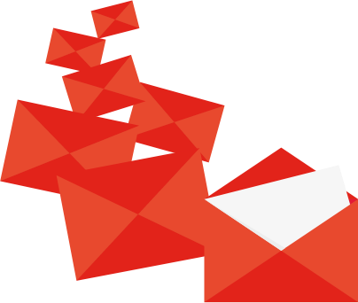
Cloud Platforms
AWS Services:
12. Messages and Notifications
AWS messaging services provide core communication for users and applications.
Amazon Simple Queue Service is a managed message queue that sends, stores, and receives messages between components of distributed applications to ensure that the parts of an application work as intended.
Amazon Simple Notification Service (SNS) enables a business to send pub-sub messages to endpoints, such as end users or services. SNS includes a mobile messaging feature that enables push messaging to mobile devices.
Amazon Simple Email Service provides a platform for IT professionals and marketers to send and
receive emails.
36

Slide 37
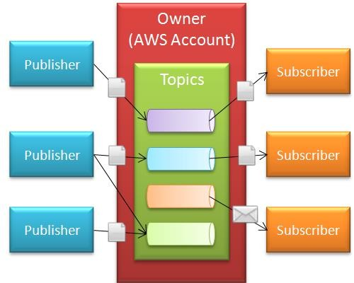
Cloud Platforms
AWS Services – SNS

Slide 38

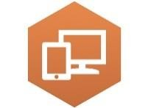

Cloud Platforms
AWS Services:
13. Other services
Amazon Web Services has a range of business productivity SaaS options.
The Amazon Chime service enables online video meetings, calls, and text-based chats across devices. A business can also take advantage of Amazon WorkDocs, a file storage and sharing service, and Amazon WorkMail, a business email service with calendaring features.
Desktop and streaming application services include Amazon WorkSpaces, a remote desktop-as-a-service platform, and Amazon AppStream, a service that lets a developer stream a desktop application from AWS to an end user's web browser.
AWS also has a variety of services that enable internet of things (IoT) deployments. The AWS IoT service provides a back-end platform to manage IoT devices and data ingestion to other AWS storage and database services. The AWS IoT Button provides hardware for limited IoT functionality, and AWS Greengrass brings AWS compute capabilities to IoT devices.
38

Slide 39
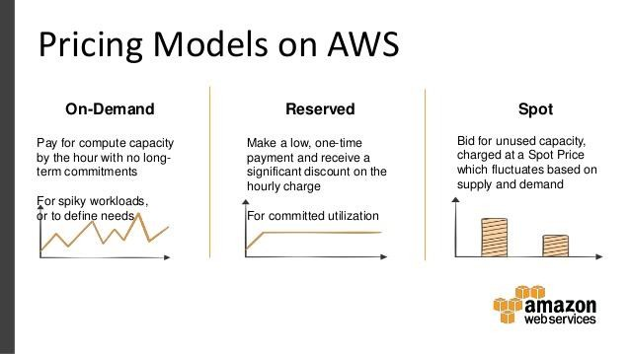
Cloud Platforms
AWS pricing models
AWS offers a pay-as-you-go model for its cloud services either on a per-hour or a per-second basis.
There is also an option to reserve a set amount of compute capacity at a discounted price for customers who prepay in whole, or who sign up for one- or three-year usage commitments.
33

Slide 40
Cloud Platforms
Microsoft Windows Azure

Slide 41
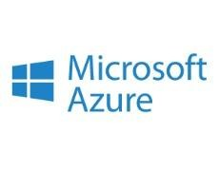
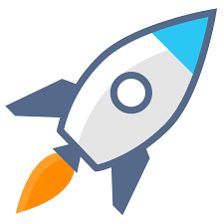
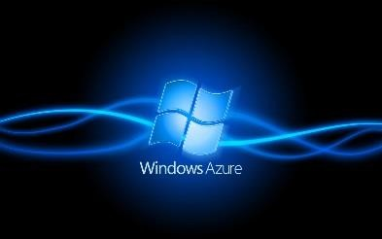
Cloud Platforms
Microsoft Windows Azure
Microsoft Azure, formerly known as Windows Azure, is a Microsoft's public cloud computing platform.
Azure is Microsoft’s PaaS strategy that was announced in 2008. Microsoft defines the Azure platform as “an Internet-scale cloud services platform hosted in Microsoft data centers, which provides an operating system and a set of developer services that can be used individually or together.”
It provides a range of cloud services, including those for compute, analytics, storage, and networking. Users can pick and choose from these services to develop and scale new applications, or run existing applications, in the public cloud.
For interoperability, Microsoft supports various Internet protocols, including HTTP, REST, SOAP, and XML.

Slide 42
Cloud Platforms
Azure platform
The Azure platform is composed of four different components:
Windows Azure: This Windows environment runs applications locally and stores the related data on servers inside the Microsoft data center.
Microsoft .NET Services: These are the same .Net services that Microsoft has in its Windows
environment. It has been extended to support cloud-based as well as on-premise applications.
Microsoft SQL Services: These are the same data services Microsoft offers on premise that have been extended to the cloud. However, if you want to take advantage of Azure’s scaling capability, you must rewrite the SQL code. The goal of SQL services is to provide an asset of cloud-based approaches for storing the data in the cloud. The data services expose both SOAP and REST interfaces as data access methods. For data storage, Azure does not use a relational model.
Live Services: This set of services allows developers to connect code developed in the Windows Live platform into the cloud. These services include a framework intended to integrate, connect, and synchronize code. The platform also includes support for different programming languages and allows all resources to include a URL address.
42

Slide 43
Cloud Platforms
Azure platform
When you put the pieces together, Microsoft has created a platform that allows developers to use familiar tools such as Microsoft’s Visual Studio and .Net services and then store the data in a Microsoft-owned cloud platform.
Microsoft has a pay-as-you-go consumption model for its PaaS offering. Microsoft does not charge for development and testing phases. It begins charging customers when the applications are deployed.

Slide 44
Cloud Platforms
Google Cloud Platform

Slide 45
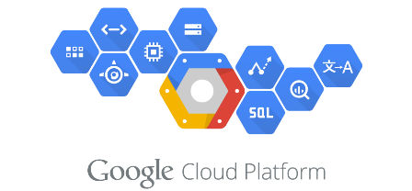
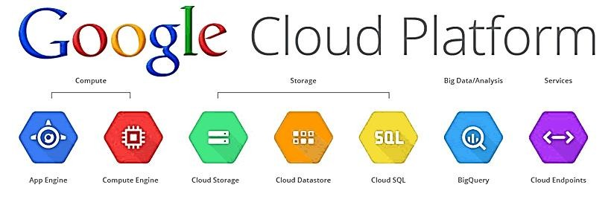
Cloud Platforms
Google Cloud Platform
Google Cloud Platform is a suite of public cloud computing services offered by Google.
Google Cloud Platform services can be accessed by software developers, cloud administrators, and other enterprise IT professionals over the public internet or through a dedicated network connection.
Google Cloud Platform offers services for compute, storage, networking, big data, machine learning, and
the internet of things (IoT), as well as cloud management, security, and developer tools.

Slide 46
Cloud Platforms
Google Cloud Platform
The core cloud computing products in Google Cloud Platform include:
Google Compute Engine, which is an infrastructure as a service (IaaS) offering that provides users with virtual machine instances for workload hosting.
Google App Engine, which is a platform as a service (PaaS) offering that gives software developers access to Google's scalable hosting. Developers can also use a software developer kit (SDK) to develop software products that run on App Engine.
Google Cloud Storage, which is a cloud storage platform designed to store large, unstructured data sets. Google also offers database storage options, including Cloud Datastore for NoSQL non-relational storage, Cloud SQL for MySQL fully relational storage and Google's native Cloud Bigtable database.
Google Container Engine, which is a management and orchestration system for Docker containers that runs within Google's public cloud. Google Container Engine is based on the Google Kubernetes container orchestration engine.

Slide 47
Cloud Platforms
Salesforce.com

Slide 48
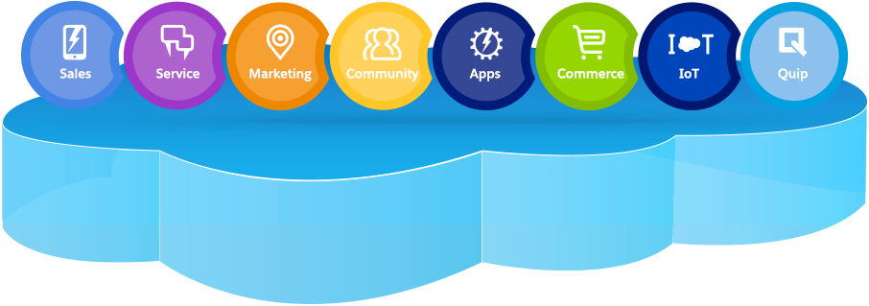
Cloud Platforms
Salesforce.com
Salesforce.com is best known for its Salesforce customer relationship management (CRM) product, which is composed of Sales Cloud, Service Cloud, Marketing Cloud, Commerce Cloud, Analytics Cloud, IoT Cloud, App Cloud, Health Cloud, Financial Services Cloud, Force.com, and Chatter.
Cloud services: Salesforce Sales Cloud manages contact information and integrates social media and real-time customer collaboration through Chatter. It supports sales, marketing, and customer support in both B2B and B2C contexts. Sales Cloud helps track customer information and interactions in one place, automates complex business processes, keeps all information up to date, nurtures leads and tracks the effectiveness of marketing campaigns.

Slide 49
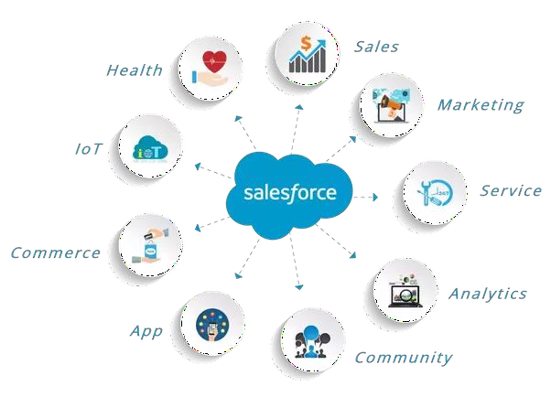
Cloud Platforms
Salesforce.com Services

Slide 50



Cloud Platforms
Salesforce.com Services
Cloud Services helps track customer information and interactions. It supports sales, marketing, and
customer support in both B2B and B2C contexts.
Marketing Cloud helps personalize email marketing, engage mobile messaging, generally manage ad campaigns for customer acquisition, and create a one-to-one customer journeys across channels.
Service Cloud is a service platform for customer service and support. It includes a call center-like case tracking feature and a social networking plug-in for conversation and analytics. It enables faster resolving of customer problems.
Community Cloud helps build communities which include customers, employees, and partners for developing deeper customer relationships. It allows customers to interact with each other, increase sales by connecting partners and boost employee productivity through online collaboration.

Slide 51

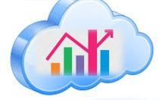
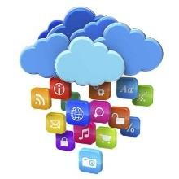

Cloud Platforms
Salesforce.com Services
Commerce Cloud allows businesses to manage digital commerce with integrated solutions for commerce,
point of sale, and order management.
Analytics Cloud is a business intelligence platform that allows organizations to instantly get important answers and start making data-driven decisions.
Salesforce App Cloud is a collection of development tools that allows developers to quickly create applications that will run on the Salesforce platform.
Salesforce IoT Cloud is a platform in Salesforce.com that harnesses the power of the internet of things (IoT) and turns data generated by customers, devices, partners, and sensors into meaningful action. It allows users to process massive quantities of data, build rules with intuitive tools and engage with customers in real time.

Slide 52

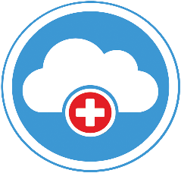
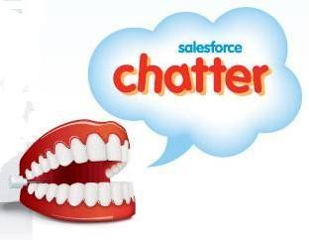
Cloud Platforms
Salesforce.com Services
9. Salesforce Financial Services Cloud helps deliver experiences that drive client loyalty through personalized tools, allows more visibility into existing household opportunities and the ability to track referrals, allows instant access to all client data in one central location, and addresses regulatory compliance.
Salesforce Health Cloud is a health IT CRM system that incorporates record management services with the doctor–patient relationship. Health cloud creates an individual profile from each member including demographics, communications, and any other pertinent information all in one location. Allows patients to track progress toward health goals and care plans.
Chatter is an enterprise social network within the Salesforce platform. It helps drive productivity by connecting employees wherever they are.

Slide 53
Cloud Platforms
Private Cloud Platforms

Slide 54
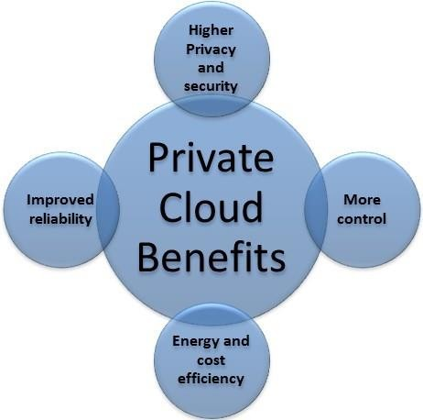
Cloud Platforms
Private Cloud
A private cloud is a particular model of cloud computing that involves a distinct and secure cloud-based
environment in which only the specified client can operate.

Slide 55
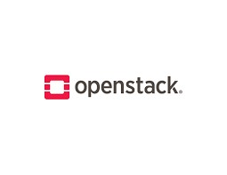
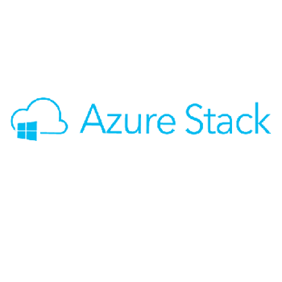

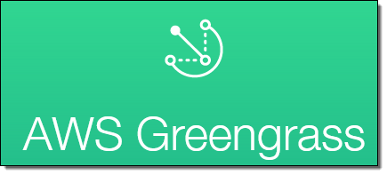
Cloud Platforms
Private Cloud Platforms
There are a host of platforms available for implementing private clouds. We will study the following three in
this chapter:
Microsoft Azure stack
Open stack
AWS Greengrass

Slide 56
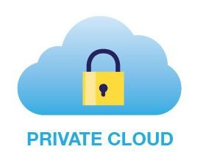
Cloud Platforms
Microsoft Azure stack
Microsoft Azure Stack is an integrated platform of hardware and software that delivers Microsoft Azure
public cloud services in a local data center.
Azure Stack offers both infrastructure as a service (IaaS) and platform as a service (PaaS) for companies that develop web apps.
With this consistent application development platform, developers can build and deploy applications the same way to the private or public cloud.
A private cloud based on Azure gives developers a consistent platform to build, test and update applications. The company can push the apps to either the Azure public cloud or keep them on-premises with Azure Stack.

Slide 57
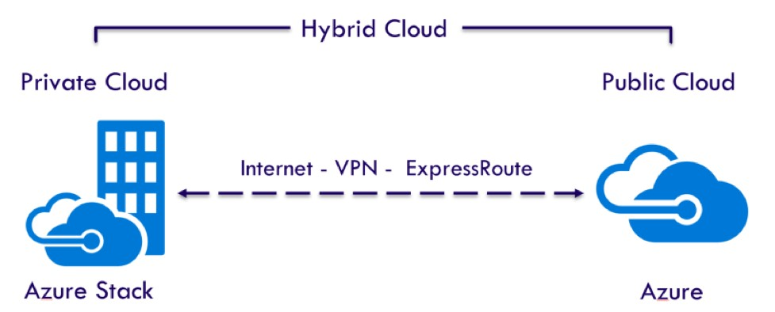
Cloud Platforms
Microsoft Azure stack
Azure Stack runs Azure identity services such as Azure Active Directory and Active Directory Federation
Services.
Azure Stack supports tools such as Azure Backup and System Center Data Protection Manager for backup and restore operations, and integrates with Azure Site Recovery for replication and failover.
Pricing for Azure Stack services is based on a consumption model similar to Microsoft Azure in which fees only applies when the organization uses the services.

Slide 58
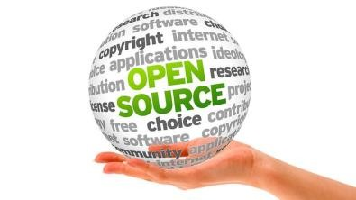
Cloud Platforms
Open Stack
Red Hat OpenStack Platform is a commercially supported distribution of open source OpenStack software designed to build and manage large pools of compute, storage, and networking resources in public and private clouds.
Red Hat OpenStack Platform provides access to open source projects, or tools, to enable core computing services in public and private clouds. OpenStack uses a consistent set of application programming interfaces (APIs) to pool and manage virtualized resources, such as storage, CPU, and RAM. Users deploy different OpenStack projects in a modular fashion depending on the resources they want to virtualize and the types of cloud services they need to enable.
The Red Hat OpenStack Platform has a director tool set to enable users to install, operate, upgrade, and manage a cloud deployment.

Slide 59
Cloud Platforms
Open Stack
The director is based on the open source OpenStack project known as TripleO (OpenStack on OpenStack). The Red Hat OpenStack Platform director makes use of the concepts of an undercloud and an overcloud.
The undercloud is the main director node that provisions and controls the OpenStack nodes in a cloud
environment.
The overcloud is the clustered server environment a user creates through the director's undercloud. Default overcloud roles include Controller, Compute, and Storage nodes that each make use of different OpenStack technologies and additional open source software.
The Controller nodes provide administration, networking and high availability (HA) to the OpenStack cloud environment.
The undercloud and overcloud require access to Red Hat storage repositories through either the Red Hat
Content Delivery Network or a Red Hat Satellite system management server.
59

Slide 60
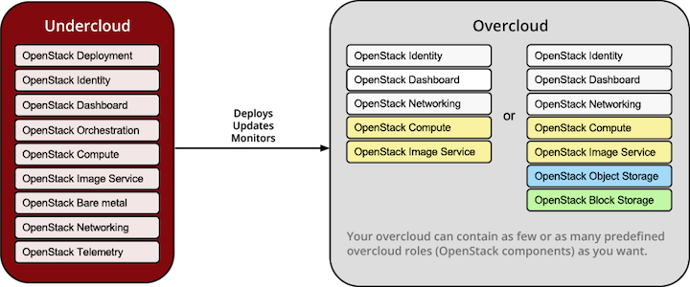
Cloud Platforms
Open Stack Platform

Slide 61

Cloud Platforms
Open Stack Platform
Core OpenStack projects available through the Red Hat platform are:
Nova for compute
Neutron for networking
Swift for object storage
Cinder for block storage
Manila for file storage
Glance for virtual machine image
discovery and storage
Keystone for identity management.

Slide 62

Cloud Platforms
AWS Greengrass
AWS Greengrass is a service that extends Amazon Web Services functionality to Internet of Things (IoT) devices, allowing a business to perform data collection and analysis closer to its origin. An IT team defines and configures Greengrass devices, permissions, applications, and updates from the Amazon Web Services public cloud.
A developer can write AWS Lambda functions and deploy them for Greengrass. The Lambda functions then execute locally on Greengrass devices when data is received from events or cloud messages. Greengrass secures data with authentication and authorization at both the network- and device-level.
The two primary software packages for AWS Greengrass are:
AWS Greengrass Core
AWS IoT Device SDK
Devices that run AWS Greengrass Core and the AWS IoT Device SDK interact with each other to form a
Greengrass Group.

Slide 63

Cloud Platforms
AWS Greengrass
AWS Greengrass Core software supports the local execution of applications based on Lambda functions.
The AWS IoT Device SDK enables devices to connect and interact with the Greengrass Core. The AWS IoT Device SDK supports C++ for Greengrass and can run on any device that supports Transport Layer Security.

Slide 64

Cloud Platforms
AWS Greengrass

Slide 65

Cloud Platforms
Impact of Cloud Platforms

Slide 66



Cloud Platforms
Impact of Cloud Platforms
As the cloud computing market expands and develops, cloud computing is expected to impact business in five distinct ways: economically, operationally, technologically, culturally, and in terms of security management.
Economical impact: businesses will begin to realize savings and economies of scale as they begin to pay
only for the services they use.
Operational impact: lessening of control for IT managers, as the majority of IT maintenance and support will be outsourced to cloud providers. Cloud providers will provide standard options and packages for maintenance and support, but the offerings will be much less collaborative than traditional service provider applications. On the plus side, increased agility, scalability, and changes in billing models will benefit organizations adopting cloud-based applications.

Slide 67

Cloud Platforms
Impact of Cloud Platforms
Security: since cost of security management is shared among a number of clients, cloud providers, in theory, are able to devote significantly more time, energy, and expertise to security management than a single company normally would. However, this is highly dependent on the vendor.
Cultural impact: The cultural impact of the transition to the cloud is likely to be significant. It will involve redefining the roles of IT professionals and business owners, and restructuring IT support for end users. Business owners will need to decide who makes decisions regarding the selection of cloud vendors, applications, etc. Likewise, end users may need to redirect their IT help desk concerns from internal IT resources to the cloud provider’s IT service.
While cloud computing is not yet fully developed, and still has room for future improvement, it is very likely that all businesses will work at least partially from the cloud within the next couple of years – most businesses already do.

Slide 68
Cloud Platforms
Self Assessment Question
A cloud platform is:
A platform to let developers write applications that run in the cloud
A platform to use services provided from the cloud
Both A and B
None
Answer: c

Slide 69
Cloud Platforms
Self Assessment Question
Which of the given options is NOT a criteria for evaluating cloud platforms
Cost
An application
Service level agreement
Cost
Answer: B

Slide 70
Cloud Platforms
Self Assessment Question
AWS stands for .
Amazon Web Services
Amazon Web Solutions
Answer: A

Slide 71
Cloud Platforms
Self Assessment Question
AWS offers:
IaaS
PaaS
SaaS
All the above
Answer: D

Slide 72
Cloud Platforms
Self Assessment Question
An Availability Zone represents a location that typically contains multiple physical data centers, while a region is .
An availability zone which contains a single data center
A collection of Availability Zones in geographic proximity connected by low-latency network links
Answer: B

Slide 73
Cloud Platforms
Self Assessment Question
The AWS service that provides virtual servers for compute capacity is .
Hypervisor
EC2
Answer: B

Slide 74
Cloud Platforms
Self Assessment Question
AWS Elastic Beanstalk is used for .
PaaS
Serverless functions
Answer: A

Slide 75
Cloud Platforms
Self Assessment Question
is used for long-term cold storage of data in AWS.
Snowball
Glacier
Answer: B

Slide 76
Cloud Platforms
Self Assessment Question
S3 stands for:
Simple Storage Service
Synchronized Storage Service
Answer: A

Slide 77
Cloud Platforms
Self Assessment Question
AWS snowball is used:
To execute highly complex computations
To physically transport data to Amazon servers.
Answer: B

Slide 78
Cloud Platforms
Self Assessment Question
The AWS NoSQL database service is
MariaDB
PostgreSQL
NoSQL
DynamoDB
Answer: D

Slide 79
Cloud Platforms
Self Assessment Question
Users can establish a dedicated connection from an on-premises data center to the AWS cloud via
.
AWS Direct Connect
Amazon Route 53
EC2
S3
Answer: A

Slide 80
Cloud Platforms
Self Assessment Question
Amazon Route 53 is:
Service to balance network traffic
Domain name system provided by amazon that routes end users to applications
Answer: B

Slide 81
Cloud Platforms
Self Assessment Question
enables a development team to create, manage and monitor custom APIs
Amazon EC2
AWS command-line
Amazon API Gateway
AWS CodeCommit
Answer: C

Slide 82
Cloud Platforms
Self Assessment Question
We can use to monitor the health of applications and resources in AWS.
Chef
Amazon CloudWatch
Answer: B

Slide 83
Cloud Platforms
Self Assessment Question
IAM allows admins to:
Store data
Update services
Connect cloud resource to Microsoft active directory
Create and manage users
Answer: D

Slide 84
Cloud Platforms
Self Assessment Question
The amazon text-to-speech translation service is called .
Amazon Lex
Amazon Rekognition
Amazon Polly
Alexa
Answer: C

Slide 85
Cloud Platforms
Self Assessment Question
The Azure platform consists of:
Windows azure, Microsoft .NET services, Microsoft SQL services, and Live Services
Windows azure, Microsoft .NET services, Microsoft SQL services, and Microsoft Office
Answer: A

Slide 86
Cloud Platforms
Self Assessment Question
is the Google cloud platform’s PaaS offering
Google App Engine
Google Container Engine
Answer: A

Slide 87
Cloud Platforms
Self Assessment Question
is the best platform for Customer Relationship Management (CRM).
Google App Engine
Salesforce.com
Answer: B

Slide 88
Cloud Platforms
Self Assessment Question
The enterprise social network within Salesforce platform is:
Chatter
Twitter
Answer: A

Slide 89
Cloud Platforms
Self Assessment Question
is the platform that delivers Microsoft Azure private cloud services.
Azure Stack
Windows Azure
Answer: A

Slide 90
Cloud Platforms
Document Links
Topics | URL | Notes
Cloud platforms | http://www.davidchappell.com/CloudPlatforms- -Chappell.pdf | This pdf examines the cloud platforms and its components
AWS | https://searchaws.techtarget.com/definition/Am azon-Web-Services | This link explains AWS and its services in brief.
Microsoft Azure | https://searchcloudcomputing.techtarget.com/defi nition/Windows-Azure | This link explain Microsoft azure platform and the services it offers.
Google cloud platform | https://searchcloudcomputing.techtarget.com/defi nition/Google-Cloud-Platform | The link discusses the services offered by the cloud platform.
Impact of cloud platforms | https://www.syseng.com/white_paper/cloud- computing-take-cloud-assessing-impact-cloud- computing-business/ | This link discusses the impact of cloud platforms.
Microsoft Azure Stack | https://searchwindowsserver.techtarget.com/defin ition/Microsoft-Azure-Stack | The link explains azure stack for hybrid clouds.
OpenStack | https://searchstorage.techtarget.com/definition/R ed-Hat-Enterprise-Linux-OpenStack-Platform | The link gives an overview of openstack
AWS Greengrass | https://searchaws.techtarget.com/definition/AWS- Greengrass | This link explains AWS Greengrass.

Slide 91
Cloud Platforms
Video Links
Topics | URL | Notes
Cloud platforms | https://www.youtube.com/watch?v=wKMmA7b gSBc | This video defines how the cloud platform works.
AWS | https://www.youtube.com/watch?v=r4YIdn2eT m4 | This video explains AWS and its services in brief.
Microsoft Azure | https://www.youtube.com/watch?v=rfSYypHtuUw | This video describes Microsoft azure platform.
Google cloud platform | https://www.youtube.com/watch?v=COhwhZjcjw0 | The video gives an overview of Google cloud.
Impact of cloud platforms | https://www.youtube.com/watch?v=vIn8_o56_cg | This video discusses the impact of cloud platforms.
Microsoft Azure Stack | https://www.youtube.com/watch?v=egmPQ9eROn s | The video explains azure stack for hybrid clouds.
OpenStack | https://www.youtube.com/watch?v=c1GFoY4btpo | The video gives an overview of openstack
AWS Greengrass | https://www.youtube.com/watch?v=1rLxPOxVJoQ | The video gives an overview of AWS Greengrass

Slide 92

Cloud Platforms
Cloud Migration

Slide 93
Cloud Platforms
Cloud Migration and Risks
Delivering Business Processes from the Cloud
Business process examples
Broad Approaches to Migrating into the Cloud
The Seven-Step Model of Migration into a Cloud, Efficient Steps for migrating to a cloud
Risks: Measuring and assessment of risks
Company concerns Risk Mitigation methodology for Cloud computing
Case Studies

Slide 94

Cloud Platforms
Delivering Business Processes from the Cloud
Business processes such as payroll, email, printing, or e-commerce delivered over the internet as a service
can be termed as “Business Process as a Service” or BPaaS.
Traditionally business processes were automated into a program. For example, if a company wanted to make sure that a management system for orders looked up a credit check before issuing a transaction, the company built that request into a program.
With the advent of cloud computing, this approach is starting to change. Increasingly, companies are looking at a more service-oriented approach to services.
For example, instead of investing and maintaining servers for email. Email can be accessed as a service
through a cloud provider.

Slide 95
Cloud Platforms
Business Process Examples
For a concrete example of BPaaS, think about certain kinds of tasks that businesses may need done on a regular basis. One example is transaction management. Credit card transactions may need to be recorded in a central database, or otherwise handled or evaluated.
Business processes span industries, both vertical and horizontal, and can include any type of business operation. Examples include:
Manufacturing – an product assembly process, a quality assurance process, a corrective/preventive maintenance process.
Finance – an invoicing process, a billing process, a risk management process
Health – a medical assessment, a drug approval
Banking – customer on-boarding, credit check
Travel – trip booking, agent billing
HR – a starters process, a leavers process, vacation request
Public Sector – application for a government service

Slide 96

Cloud Platforms
Migrating to the Cloud:
Cloud migration is the process of moving data, applications or other business elements from an organization's onsite computers to the cloud, or moving them from one cloud environment to another.
Moving data or business elements from one cloud environment to another is called “cloud-to-cloud migration”.
The process of transitioning to a different cloud provider is called “cloud service migration”.
A successful migration to a cloud requires the use of middleware, such as a cloud integration tool.
33

Slide 97




Cloud Platforms
Broad Approaches to Migrating to the Cloud:
There are three common approaches to migrate the on-premise applications to the cloud. They are:
Lift and Shift
the Lift and Shift approach involves the exact replication of the in-house applications in the cloud. There is no change made to the code or the design of applications. It involves much lesser time, cost, and complexity when compared to other methods. Storage infrastructure and disaster recovery are common applications migrated using this approach.
Refactoring
Refactoring refers to changes made in the structure of the source code of the application in order to make it more efficient. The code is modified such that it becomes more scalable and reusable without changing the functions of the application.
Modernisation
The modernisation application approach to cloud computing redesigns the application from
ground-up, thus making it completely flexible for the cloud environment.
34

Slide 98
Cloud Platforms
The Seven-Step Model of Migration into the Cloud
Re- architect
Assess
Isolate
Map
Augment
Test
Optimize
33

Slide 99



Cloud Platforms
Migrating to the Cloud:
Step 1: Assess
Cloud migration assessments are conducted to understand the complexities in the migration process at the code, design, and architectural levels. The investment and the recurring costs are also evaluated along with gauging the tools, test cases, functionalities, and other features related to the configuration.
Step 2: Isolate
The applications to be migrated to the cloud from the internal data center are freed of dependencies pertaining to the environment and the existing system. This step cuts a clearer picture about the complexity of the migration process.
Step 3: Map
Most organizations hold a detailed mapping of their environment with all the systems and applications. Make use of this information to distinguish between the components that have to be moved to the cloud from the ones that should continue to reside in the data center.
33

Slide 100




Cloud Platforms
Migrating to the Cloud:
Step 4: Re-Architect
Migration to the cloud demands re-architecting of applications in most cases. This may result in the loss of certain functionalities and this can be approximated by using relevant APIs.
Step 5: Augment
The applications are augmented to make them cloud-ready. Augmenting the applications is crucial to derive the best benefits of the cloud.
Step 6: Test
Right after the applications are augmented, they need to be tested for the new environment. The augmentation and migration strategies are validated at this step.
Step 7: Optimize
On the basis of the test results, the migration strategy is optimized for delivering the best ROI. A
roadmap for leveraging the new cloud features is laid.
33

Slide 101

Cloud Platforms
Efficient Steps for Migrating to the Cloud
As cloud computing gains momentum, organizations are looking for a more robust way to approach the cloud. In order to leverage the benefits of the cloud, a strong cloud strategy must be in place. Based on the approach framed by the popular research firm, The Burton Group, the following five steps define the framework for a strong cloud adoption strategy.
1. Pre-Work
To start with, organizations must build an internal cloud team, which together will set the scope of the cloud project. Expectations, standards to be achieved and cloud objectives must be well defined during the initial stages of the cloud journey.
2. Business and Application Analysis
The cloud cannot be considered as plainly a technical enhancement since it has a strong impact on the various business functions. During this stage, business applications moving into the cloud are evaluated based on the costs and architectural requirements. The operational changes to be made within an organization are also determined. The four significant components of this stage are business impact evaluation, assessment of organizational impact, cost analysis, and application analysis.
33

Slide 102

Cloud Platforms
Efficient Steps for Migrating to the Cloud
Selecting the Cloud Service Provider
Solutions from different cloud service providers are reviewed and the most suitable one is chosen. The migration plan is initiated and the roadmap to cloud is thus made clear.
Building the Risk Mitigation Plan
No cloud adoption framework can be complete without the risks and challenges being included. A risk mitigation plan is drawn and the exit strategy is devised.
Planning for the Steady State
Once applications are moved to cloud, there needs to be a plan in place for the cloud governance and vendor management. Regular reviews of the strategy must be conducted and the cloud team must ensure that both internal processes and personnel issues are addressed during the move.
33

Slide 103
Cloud Platforms
Migration Failure and Contingency Measures
Not every cloud migration project is successful. Without the required resources, knowledge and skillset, cloud migration can turn out to be a nightmare. Outlined below are some contingency measures that mitigate risks considerably during the cloud migration process.
Poor planning is the most common reason for the failure in any IT project. The entire life cycle of the migration project must be planned ahead. Every specific task and the allocated responsibility of the task must be documented.
The changes pertaining to people, processes and culture of the organization must be addressed. The required training and technical support must be implemented.
Security of data during migration process is highly crucial. The cloud service provider must hold all the accreditations that can insulate the client from any chances of a data breach or failure to adhere to industry compliance requirements.
The cloud service provider must be ISO 27001 certified to assure its ability to offer the maximum security for all systems and data.
A robust SLA must be drawn with the service provider. They must commit to a specific level of service, failing which they must be prepared to fulfil the compensation policy mentioned in the SLA.
33

Slide 104

Cloud Platforms
Risks
104

Slide 105
Cloud Platforms
Measurement and Assessment of Risks
The risk assessment strategy used by an organization must contain the following elements:
Effective Control Mechanism: All the current controls over data are to be analyzed. If it does not provide adequate protections for the data or service, then necessary data control mechanisms are to be implemented.
Necessary Periodical Audits: The cloud service provider and the services rendered are to be analyzed and audited on a monthly, quarterly, or annual basis. Any kind of discrepancies in service should be noted, informed, and necessary corrective measures are to be implemented.
Technical Security Architecture: A thorough analysis of the present technical architecture of the cloud service provider should be done. Firewalls, Virtual Private Network provisions, patching, intrusion prevention mechanism and network segregation are few things to be analyzed well. These are potential high-risk areas especially when confidential customer data is at stake.
Data Integrity: The cloud service provider would be rendering the services to multiple clients at a time. How well the data are stored, what kind of hardware is being used, if the confidential data are being stored in a shared storage etc. – are to be analyzed and understood beforehand. It is much better to have discussions with the cloud service provider before even moving all the data to the cloud.
33

Slide 106
Cloud Platforms
Measurement and Assessment of Risks
Data Encryption: The name says it all. The data encryption standards that the cloud service providers utilize is to be audited beforehand. Strict investigation has to be carried out in this aspect, as its one of the high-risk areas. Sony suffered a major outage in its PlayStation Network in 2011 due to their poor data encryption standards and hackers exploiting it.
Disaster Recovery Plan: What happens when there is an earthquake? Or flooding (or) some other natural calamity that hits the data center in which all the confidential data is being stored? Before getting into contracts, the disaster recovery and contingency plan provided by the cloud service provider should be reviewed thoroughly. Internally, the organization should have a clear business continuity plan to ensure that the business doesn't get affected if in case there is a disaster.
Standard Procedures: Its good to evaluate the standard procedures followed by the cloud service provider internally in their operations. A typical example would be the offsite tape backup procedure for all the data stored in their data center. Another example would be a background pre-employment screening procedure to see if any of the employees working at the data center (or) those to be involved in managing the data center has any malicious intent.
33

Slide 107
Cloud Platforms
Measurement and Assessment of Risks
Business Operations of the Cloud Service Provider: The current operational and financial conditions of the cloud service provider should be diligently verified along with the history of operations. For publicly traded companies, its easy to find this information. For private companies, either an internal team can do the due-diligence (or) a third-party can do the background check.
33

Slide 108
Cloud Platforms
Cloud Risk Mitigation Strategies
Some of the most effective cloud risk mitigation strategies are
Due-Diligence on Various Cloud Solutions
Cloud computing leads to a higher dependence on cloud-based vendors and thus demands clients of an evaluation of their capabilities beforehand. Optimized security measures, industry recognized compliance standards and the ability to support the unique requirements of an expanding organization must be analyzed to mitigate the risk potential in a cloud project.
Adapting Encryption Standards
Encryption of data is the act of converting sensitive data into undecipherable text by using the relevant algorithms. The encrypted data is called ciphertext, and the level of encryption depends on the sensitivity of the data. Encryption solutions are of two types:
Provider-side cloud encryption: The cloud service provider encrypts the data received from clients and adds an extra layer of protection from potential threats. Many leading cloud vendors in the market, such as Amazon, Microsoft, and EMC, offer these solutions to their clients.
Client-side cloud encryption: Companies dealing with multiple cloud vendors make use of cloud encryption gateways to turn their plain text data into ciphertext. Encryption makes the text unreadable without a special key.
33

Slide 109
Cloud Platforms
Cloud Risk Mitigation Strategies
Secure Third Party Validation
Cloud security is better said than done. Not every cloud service provider is successful in keeping up with the security demands of the customer. This makes third party validation a must for cloud solutions. Independent technology auditors assess the solutions to ensure that they are capable of delivering the desired results.
User Access Controls
The risk of unauthorized access to critical information exists in both private and public cloud environments. As opposed to the application-based access control in the traditional system of computing, cloud environments work better with Role-Based Access Control (RBAC). In this method, users of the system are assigned a specific role and can perform a precise set of functions based on this role. By restricting access to cloud resources, unauthorized access, accidental manipulation of data, and sharing of credentials can be prevented.
33

Slide 110
Cloud Platforms
Cloud Risk Mitigation Strategies
Service-Level Agreements and SSO Solution
A robust service-level agreement holds the key to the performance levels of every element of the service provided by the cloud vendor. It affirms the ownership of data and lays the foundation for the security measures to be adopted during implementation.
The Single Sign-On (SSO) is one way of mitigating risk when it comes to protecting user data. The user logs in using his/her email id (or) any id that has been created along with the password to a particular application through the web browser. Once he/she logs in, the sessions starts and all user information is encrypted and stored using specific protocols. After the user logs in, he/she may use any of the connected systems (or) applications without having to login multiple times. For example, Gmail and all other applications of Google. In a browser, if the user has signed into Gmail (or) Youtube once, then there is no need to sign-in again and again for other Google applications. He/she can access Google Docs, Drive, PlayStore, etc. without having to login to each of these applications. The SSO technique eliminates the need for multiple re-authentications while using the system (or) set of applications and thus prevents authentication requests to be made to the server back and forth every time the user wants to use a particular application.
33

Slide 111
Cloud Platforms
Cloud Risk Mitigation Strategies
Hybrid Approach
A recent study conducted by Avanade, a business technology and managed services provider revealed that more than 60% of the participants believed that the hybrid approach (the blending of private and public cloud) was a safer way to conduct business in the cloud. This model of cloud computing allows organizations to host their most sensitive data internally while allowing the other secondary functions to reside on the public infrastructure. It offers the highest level of flexibility with no additional capital expense. With more business critical applications moving to the cloud, hybrid offers the best of both worlds.
33

Slide 112
Cloud Platforms
Top Company Concerns
Some of the top questions company’s consider when moving to cloud are:
What are my security and privacy concerns?
These are two of the top concerns that companies cite about a move to the cloud. In most circumstances, cloud security needs to be approached from a risk-management perspective. If your organization has risk-management specialists, involve them in cloud security planning.
How available and reliable will my resources be?
When you ran the data center, availability, and reliability were under your own company control. Your IT organization probably has negotiated certain service level agreements with the departments in your company based on the criticality of your applications. With a move to the cloud, you need to ask yourself what levels of availability you need and what risk you are willing to take if your service provider does not meet agreed-upon levels. There may be some applications where you are willing to take the risk and somewhere you are not. But you need to assess the risk. Remember too that you may not be compensated the way you think you should be if your provider’s service goes down.
33

Slide 113
Cloud Platforms
Top Company Concerns
What about my data?
If you are thinking about moving applications and data to the cloud, you need to address a number of questions. These include, but are not limited to, the following:
Can my data be stored anywhere or does my company not allow data to cross country boundaries?
What happens if the data are lost?
Can I recover?
Who owns my data?
Is my vendor viable?
What happens if your service provider goes out of business? Will you be able to recover your assets? Who owns the intellectual property?
33

Slide 114
Cloud Platforms
Top Company Concerns
Will I be locked into one vendor?
Although there are some movements to move to an open cloud model, the cloud is not there yet. This means there are proprietary data formats and APIs out there. Assess what they are and whether it will be easy to move your assets from one provider to another.
Are there other compliance or regulatory issues I need to be aware of?
Make sure that your provider can adhere to any regulatory or compliance issues your company has in place. You also need to make sure that they are willing to change if something changes in your own industry. Assess the risk and the cost that might be associated with this.
33

Slide 115
Cloud Platforms
Case Studies
115

Slide 116
Cloud Platforms
Case Study I
SmugMug : Migration to Cloud using AWS The case scenario
SmugMug is a popular photo and video-sharing service that stores billions of customer photos and videos. As the company began to grow in volume, the team at SmugMug could not afford to invest in data centers to support their growth. They wanted a solution that could ensure easy storage with maximum security for their customers.
33

Slide 117

Cloud Platforms
Case Studies
SmugMug : Migration to Cloud using AWS
33

Slide 118
Cloud Platforms
Case Studies
SmugMug : Migration to Cloud using AWS
The Solution
The journey to cloud for SmugMug began with AWS solutions. Initially, they adopted the Amazon S3 solution for backup of data from their local data centers. Overwhelmed by the performance of the system, they soon made the Amazon S3 their source of primary storage. The next step was to transfer their computer services into the cloud by using the Amazon EC2 solution. With Amazon EC2, SmugMug moved many of its specialized services to the cloud.
Through this very carefully crafted phased migration to the cloud, SmugMug derived the following benefits.
Increased cost savings
Economies of scale
Increased employee productivity
Faster operations
Ensured security of photos and videos
33

Slide 119
Cloud Platforms
Case Study II
Ramco(On-premise) to Ramco on Demand The case scenario
Ramco Systems is a leader in providing ERP solutions to thousands of companies across the world. With more than 150,000 users Ramco Systems had to draw the balance between offering competent capabilities and meeting the service level agreements. They needed to provision servers instantly to the varying demands of their customers and also contend with the increasing costs of capital investment, security measures, and power supply.
33

Slide 120

Cloud Platforms
Case Study II
Ramco(On-premise) to Ramco on Demand
33

Slide 121
Cloud Platforms
Case Study II
Ramco(On-premise) to Ramco on Demand The Solution
Ramco Systems found its ideal solution from the extensive portfolio of services offered by AWS. Its journey to the cloud started by adopting the Amazon Elastic Compute Cloud which later went on to include other services such as storage, email, resource monitoring, etc.
Today Ramco Systems experiences the following benefits through successful migration to the cloud.
Provisioning of servers has been enhanced by 80%.
Cost-effective disaster recovery.
ERP solutions that are more comprehensive, scalable, and flexible.
33

Slide 122
Cloud Platforms
Case Study III
Sony PlayStation Network Outage 2011
Case Scenario:
Sony Corporation first introduced the PlayStation Console in December 1994 in Japan. Since then, the product has undergone a series of upgrades and enhancement. The latest version of the PlayStation called PS3 was a complete entertainment package and included internet browsing capabilities, chat functions, media downloads, and gaming options. Registered users of the system were more than 75 million, and a huge chunk had also recorded sensitive information like credit card details for the purpose of online purchases.
The Outage
On 19 April 2011, Sony’s PlayStation Network experienced one of the worst cases of data security breach in the history of IT. The servers were hacked by an unauthorized group leading to the theft of usernames, passwords, credit card details and other personal information of millions of PSN users. The system was shut down for almost 7 days following the attack. The cause of the incident was mainly due to the poor security mechanisms of Sony and its failure to encrypt critical data.
33

Slide 123
Cloud Platforms
Case Study III
Sony PlayStation Network Outage 2011
Impact:
This unfortunate event for Sony brought down its reputation, credibility, and stock value. Sony rebuilt its security system, faced a lawsuit that was settled after almost 4 years and paid huge compensation to its customers who were exposed to the incident. The service was made to shut down for almost 3 weeks, and the cost of the outage was over 170 million dollars.
33

Slide 124
Cloud Platform
Self Assessment Question
BPaaS stands for .
Business Projects as a Service
Business Process as a Service
Answer: B
124

Slide 125
Cloud Platform
Self Assessment Question
Google encrypts all critical data that is stored on its cloud. The cloud encryption solution offered by Google can be called:
Provider-side cloud encryption
Client - side cloud encryption
Cipher texts
None of the above
Answer: A
124

Slide 126
Cloud Platform
Self Assessment Question
What type of cloud is associated with the risk of shared access?
Public Cloud
Private Cloud
Hybrid Cloud
None of the above
Answer: A
124

Slide 127
Cloud Platform
Self Assessment Question
One main reason behind Sony’s data breach incident in 2011 was:
Lack of expertise
Failure to encrypt data
Shared Access
Malicious insiders
Answer: B
124

Slide 128
Cloud Platform
Self Assessment Question
The cloud migration approach that demands the least cost and complexity is .
Lift and Shift
Refactoring
Cloud Modernization
Lift and Refit
Answer: A
124

Slide 129
Cloud Platform
Self Assessment Question
Which phase of the Seven Step Cloud Migration model approximates the lost functionalities of the application?
Map
Augment
Re-architect
Isolate
Answer: C
124

Slide 130
Cloud Platform
Self Assessment Question
The main aim behind adopting the seven-step cloud migration model in an organization is .
To enhance the success rate of the migration process
To obtain a more rational view point
Both
None
Answer: C
124

Slide 131
Cloud Platform
Self Assessment Question
SSO stands for
Simple security objectives
Single Sign on
Security Service Operator
None of the above
Answer: B
124

Slide 132
Cloud Platforms
Assignment
You need to answer below sets of problem. These sets of questions are meant for testing unit III.
Define cloud platform.
Compare AWS, Microssoft Azure, and Google Platform
Explain the Salesforce.com services.
Discuss the impact of cloud platforms.
Describe Microsoft Azure Stack.
Explain AWS Greengras platform for IoT devices.
Explain the seven step model for cloud migration.
Summarise the risks involved when moving to cloud and identify the mitigation steps.
124

Slide 133
Introduction to Operating System
Summary
A cloud platform is a platform to let developers write applications that run in the cloud, or use services provided from the cloud, or both. It is also called on-demand platform and platform as a service (PaaS).
Amazon Web Services (AWS) is a comprehensive, evolving cloud computing platform provided by Amazon. It provides a mix of infrastructure as a service (IaaS), platform as a service (PaaS), and packaged software as a service (SaaS) offerings.
Microsoft defines the Azure platform as “an Internet-scale cloud services platform hosted in Microsoft data centers, which provides an operating system and a set of developer services that can be used individually or together.”
Google Cloud Platform is a suite of public cloud computing services offered by Google.
Salesforce.com is best known for its Salesforce customer relationship management (CRM) product, which is composed of Sales Cloud, Service Cloud, Marketing Cloud, Commerce Cloud, Analytics Cloud, IoT Cloud, App Cloud, Health Cloud, Financial Services Cloud, Force.com, and Chatter.
Microsoft Azure Stack is an integrated platform of hardware and software that delivers Microsoft Azure public cloud services in a local data center.
Red Hat OpenStack Platform provides access to open source projects, or tools, to enable core computing services in public and private clouds.
AWS Greengrass is a service that extends Amazon Web Services functionality to Internet of Things (IoT)
devices.
124

Slide 134
Introduction to Operating System
Document Links
Topics | URL | Notes
Delivering Business Processes from the Cloud | http://www.dummies.com/programming/cloud- computing/hybrid-cloud/what-is-business- process-as-a-service-bpaas-in-cloud-computing/ | This link examines business process as a service on cloud.
Business process examples | http://www.dummies.com/programming/cloud- computing/hybrid-cloud/how-bpaas-works-in- the-real-world-of-cloud-computing/ | This link discusses some real world examples of business processes.
The Seven-Step Model of Migration into a Cloud | https://cloudtweaks.com/2012/09/migration-into- the-cloud/ | The link explains the seven step model of migrating into a cloud.
Efficient Steps for migrating to cloud | https://www.newgenapps.com/blog/cloud- solutions-implementation | This link discusses 10 Steps to a Successful Cloud Migration
Risk Mitigation methodology for Cloud computing | https://www.neweggbusiness.com/smartbuyer/ov er-easy/5-ways-mitigate-cloud-computing-risks/ | The link discusses the risks and the mitigation steps required for cloud computing.
124

Slide 135
Introduction to Operating System
Video Links
Topics | URL | Notes
Cloud Migration | https://www.youtube.com/watch?v=9KPkuKHpZk Q | This video is the first of a 3 part series which explains the migration step, issues and methods.
Cloud computing Risks | https://www.youtube.com/watch?v=zme4OYvm4H U | The video discusses the risks of moving to cloud.
124

Slide 136
Cloud Platforms
E-Book Links
Topics | URL | Page Number
Cloud Platforms | http://www.nortonaudio.com/Ficheiros/111840873X_Cloud.pdf | Page 29 to 31
Platform as a service | http://www.nortonaudio.com/Ficheiros/111840873X_Cloud.pdf | Page 35-38
124

